Slide 1
Gray Level Co-occurrence Matrix (GLCM)
CSE523 – Digital Image Processing

Slide 2
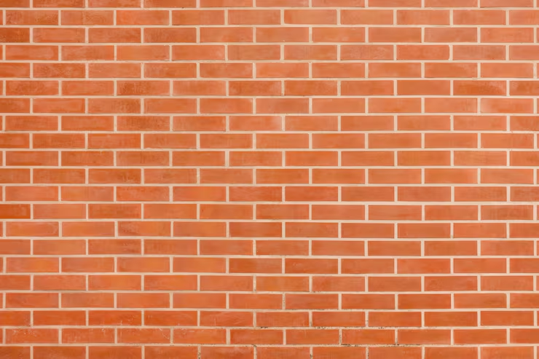

Gray Level Co-occurrence (GLCM)
Texture:
Texture in an image means how a surface looks and feels visually — whether it appears smooth, rough, bumpy, or patterned.
Texture comes from how pixel values change and repeat in a small area of the image.

Slide 3
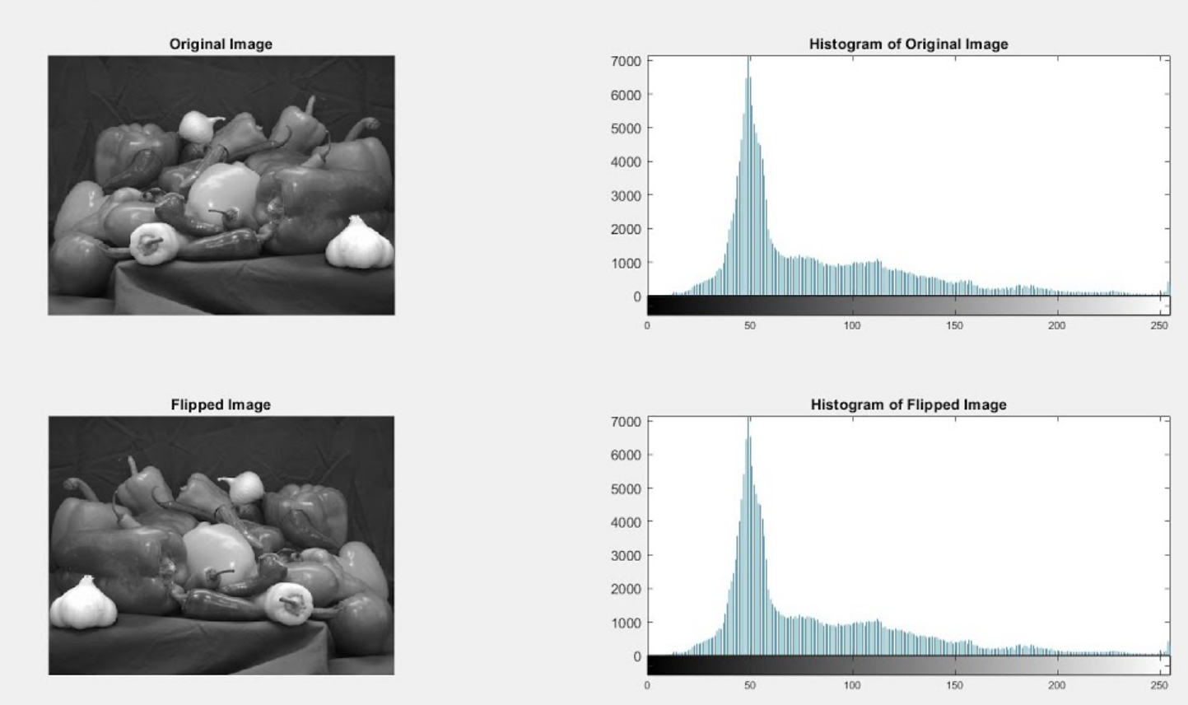
Gray Level Co-occurrence (GLCM)
Background:
An image histogram only counts how many times an intensity occurs, but not where it occurs.
Many textures have similar histograms but different spatial patterns.
Keynote:
Texture is determined not only by intensities but by their relationship.

Slide 4
Gray Level Co-occurrence (GLCM)
Background :
By studying texture, a computer can understand what kind of surface is in an image.
This helps in tasks like finding objects, separating regions, or identifying diseases in medical images.
Methods like GLCM and LBP help computers measure these texture patterns automatically.

Slide 5
Gray Level Co-occurrence (GLCM)
GLCM:
GLCM (Gray Level Co-occurrence Matrix) captures how often pairs of gray levels occur next to each other in a specific direction and distance.
It encodes spatial relationships between pixels → good for texture analysis.
It is simple and interpretable:
  the matrix itself is just co-occurrence counts;
  from it we derive well-known features (contrast, energy, homogeneity, correlation, etc.).

Slide 6
Main Mechanism of GLCM
Choose offset (distance + direction)
Quantize gray levels
01
02
06
03
Build the GLCM 𝑃(𝑖,𝑗)
Derive texture features
05
04
Symmetrization
Normalize to get probabilities

Slide 7
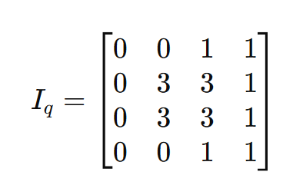
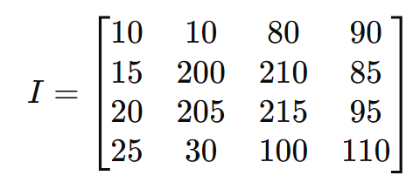
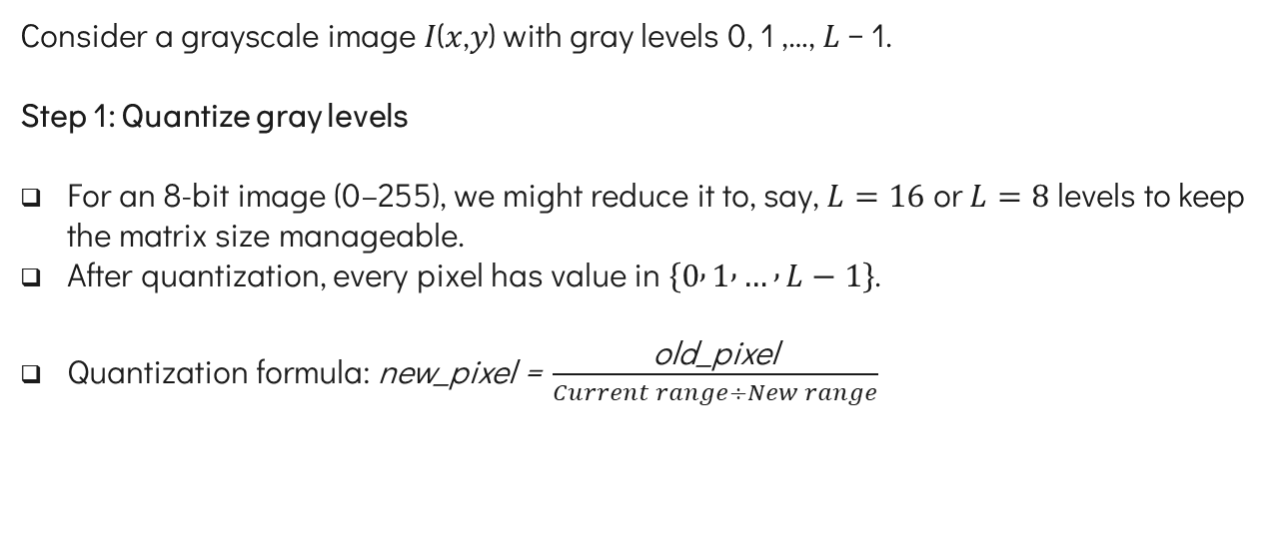
Main mechanism of GLCM
Consider a grayscale image 𝐼(𝑥,𝑦) with gray levels 0, 1 ,…, 𝐿 − 1.
Step 1: Quantize gray levels
For an 8-bit image (0–255), we might reduce it to, say, $L=16$ or $L=8$levels to keep the matrix size manageable.
After quantization, every pixel has value in $\left\{0 , 1 , … , L−1\right\}$.
Quantization formula: $\text{new}\text{_}\text{pixel} \text{=} \frac{\text{old}\text{_}\text{pixel}}{Current range÷New range}$
L = 8 bit to L = 4 bit

Slide 8
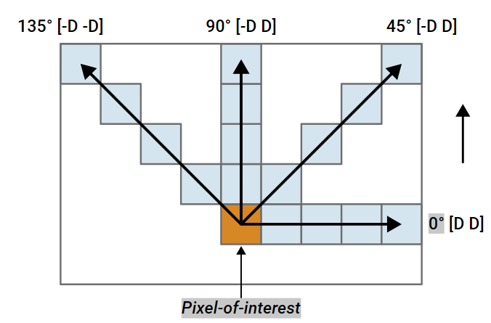

Main mechanism of GLCM
Step 2: Choose offset (distance + direction)
Choose a distance 𝑑 (e.g., 1 pixel, 2 pixels).
Choose a direction $θ$:

Slide 9
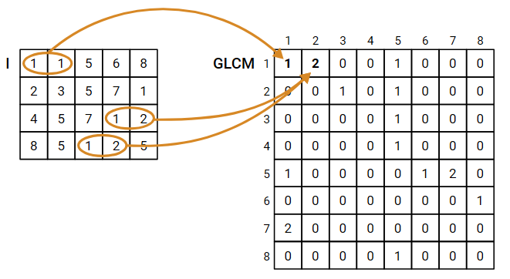
Main mechanism of GLCM
Step 3: Build the GLCM 𝑃(𝑖,𝑗)

Slide 10
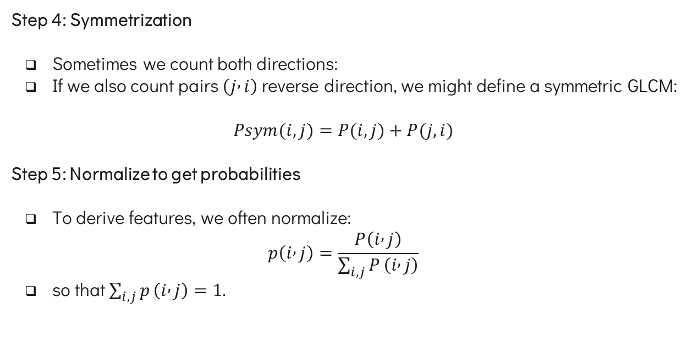
Main mechanism of GLCM
Step 4: Symmetrization
Sometimes we count both directions:
If we also count pairs $\left(j , i\right)$reverse direction, we might define a symmetric GLCM:
$$Psym​(i,j)=P(i,j)+P(j,i)$$
Step 5: Normalize to get probabilities
To derive features, we often normalize:
$$p\left(i , j\right)=\frac{P\left(i , j\right)}{\sum_{i,j}{P}\left(i , j\right)}$$
so that $\sum_{i,j}{p}\left(i , j\right)=1$.

Slide 11
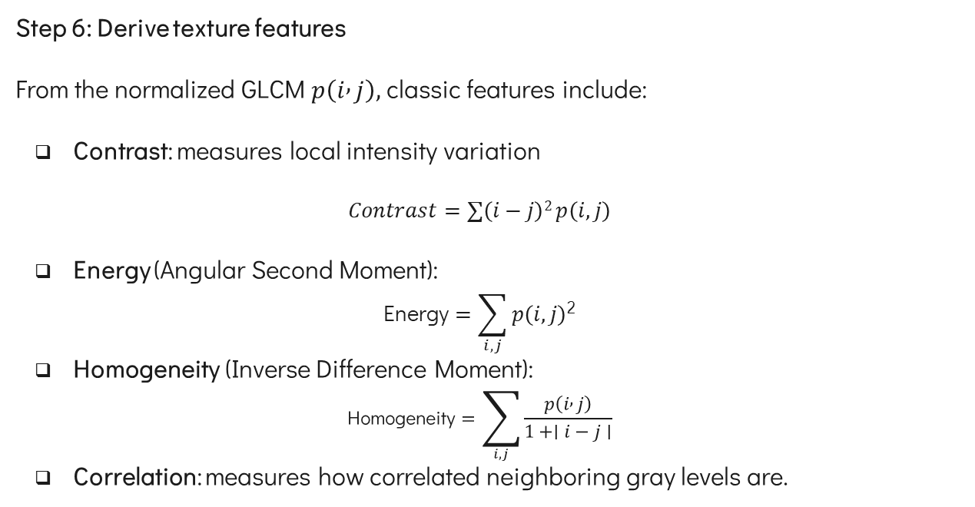
Main mechanism of GLCM
Step 6: Derive texture features
From the normalized GLCM $p\left(i , j\right),$ classic features include:
Contrast: measures local intensity variation
$$Contrast=∑​\left(i−j\right)2 p\left(i,j\right)$$
Energy (Angular Second Moment):
$$\text{Energy}=\sum_{i,j}{p\left(i,j\right)\text{2}}$$
Homogeneity (Inverse Difference Moment):
$$\text{Homogeneity}=\sum_{i,j}{\frac{p\left(i , j\right)}{1+∣i−j∣}}$$
Correlation: measures how correlated neighboring gray levels are.

Slide 12

Example
We are given the 4×4 image,
distance 𝑑 = 1 pixel.
Direction $θ=$ 0º (right side)
P(i,j) | 0 | 1 | 2 | 3
0 | (0,0) | (0,1) | (0,2) | (0,3)
1 | (1,0) | (1,1) | (1,2) | (1,3)
2 | (2,0) | (2,1) | (2,2) | (2,3)
3 | (3,0) | (3,1) | (3,2) | (3,3)
0 | 0 | 1 | 1
0 | 0 | 1 | 1
0 | 2 | 2 | 2
2 | 2 | 3 | 3

Slide 13
Example
Build the GLCM 𝑃(𝑖,𝑗)
P(i,j) | 0 | 1 | 2 | 3
0 | 2
1
2
3
0 | 0 | 1 | 1
0 | 0 | 1 | 1
0 | 2 | 2 | 2
2 | 2 | 3 | 3
For 0,0

Slide 14
Example
Build the GLCM 𝑃(𝑖,𝑗)
P(i,j) | 0 | 1 | 2 | 3
0 | 2 | 2
1
2
3
0 | 0 | 1 | 1
0 | 0 | 1 | 1
0 | 2 | 2 | 2
2 | 2 | 3 | 3
For 0,1

Slide 15
Example
Build the GLCM 𝑃(𝑖,𝑗)
P(i,j) | 0 | 1 | 2 | 3
0 | 2 | 2 | 1
1
2
3
0 | 0 | 1 | 1
0 | 0 | 1 | 1
0 | 2 | 2 | 2
2 | 2 | 3 | 3
For 0,2

Slide 16
Example
Build the GLCM 𝑃(𝑖,𝑗)
P(i,j) | 0 | 1 | 2 | 3
0 | 2 | 2 | 1 | 0
1
2
3
0 | 0 | 1 | 1
0 | 0 | 1 | 1
0 | 2 | 2 | 2
2 | 2 | 3 | 3
For 0,3

Slide 17
Example
Build the GLCM 𝑃(𝑖,𝑗)
P(i,j) | 0 | 1 | 2 | 3
0 | 2 | 2 | 1 | 0
1 | 0
2
3
0 | 0 | 1 | 1
0 | 0 | 1 | 1
0 | 2 | 2 | 2
2 | 2 | 3 | 3
For 1,0

Slide 18
Example
Build the GLCM 𝑃(𝑖,𝑗)
P(i,j) | 0 | 1 | 2 | 3
0 | 2 | 2 | 1 | 0
1 | 0 | 2
2
3
0 | 0 | 1 | 1
0 | 0 | 1 | 1
0 | 2 | 2 | 2
2 | 2 | 3 | 3
For 1,1

Slide 19
Example
Build the GLCM 𝑃(𝑖,𝑗)
P(i,j) | 0 | 1 | 2 | 3
0 | 2 | 2 | 1 | 0
1 | 0 | 2 | 0
2
3
0 | 0 | 1 | 1
0 | 0 | 1 | 1
0 | 2 | 2 | 2
2 | 2 | 3 | 3
For 1,2

Slide 20
Example
Build the GLCM 𝑃(𝑖,𝑗)
P(i,j) | 0 | 1 | 2 | 3
0 | 2 | 2 | 1 | 0
1 | 0 | 2 | 0 | 0
2
3
0 | 0 | 1 | 1
0 | 0 | 1 | 1
0 | 2 | 2 | 2
2 | 2 | 3 | 3
For 1,3

Slide 21
Example
Build the GLCM 𝑃(𝑖,𝑗)
P(i,j) | 0 | 1 | 2 | 3
0 | 2 | 2 | 1 | 0
1 | 0 | 2 | 0 | 0
2 | 0 | 0 | 3 | 1
3 | 0 | 0 | 0 | 1
0 | 0 | 1 | 1
0 | 0 | 1 | 1
0 | 2 | 2 | 2
2 | 2 | 3 | 3

Slide 22
Example
Symmetrization
2 | 2 | 1 | 0
0 | 2 | 0 | 0
0 | 0 | 3 | 1
0 | 0 | 0 | 1
2 | 0 | 0 | 0
2 | 2 | 0 | 0
1 | 0 | 3 | 0
0 | 0 | 1 | 1
4 | 2 | 1 | 0
2 | 4 | 0 | 0
1 | 0 | 6 | 1
0 | 0 | 1 | 2
CM of the image
Transpose CM of the image
Symmetric GLCM

Slide 23
Example
Normalization
Sum of all elements = 24
4 | 2 | 1 | 0
2 | 4 | 0 | 0
1 | 0 | 6 | 1
0 | 0 | 1 | 2
0.167 | 0.083 | 0.0416 | 0
0.083 | 0.167 | 0 | 0
0.0416 | 0 | 0.25 | 0.0416
0 | 0 | 0.0416 | 0.083
Symmetric GLCM
Normalized GLCM

Slide 24
Example
Contrast
Contrast = 0.582
P(i,j) | 0 | 1 | 2 | 3
0 | 0 | 1 | 4 | 9
1 | 1 | 0 | 1 | 4
2 | 4 | 1 | 0 | 1
3 | 9 | 4 | 1 | 0
0.167 | 0.083 | 0.0416 | 0
0.083 | 0.167 | 0 | 0
0.0416 | 0 | 0.25 | 0.0416
0 | 0 | 0.0416 | 0.083
0 | 0.083 | 0.1664 | 0
0.083 | 0 | 0 | 0
0.1664 | 0 | 0 | 0.0416
0 | 0 | 0.0416 | 0
| I – J |²
Normalized GLCM p (i,j)
| I – J |² x p (i, j)

Slide 25
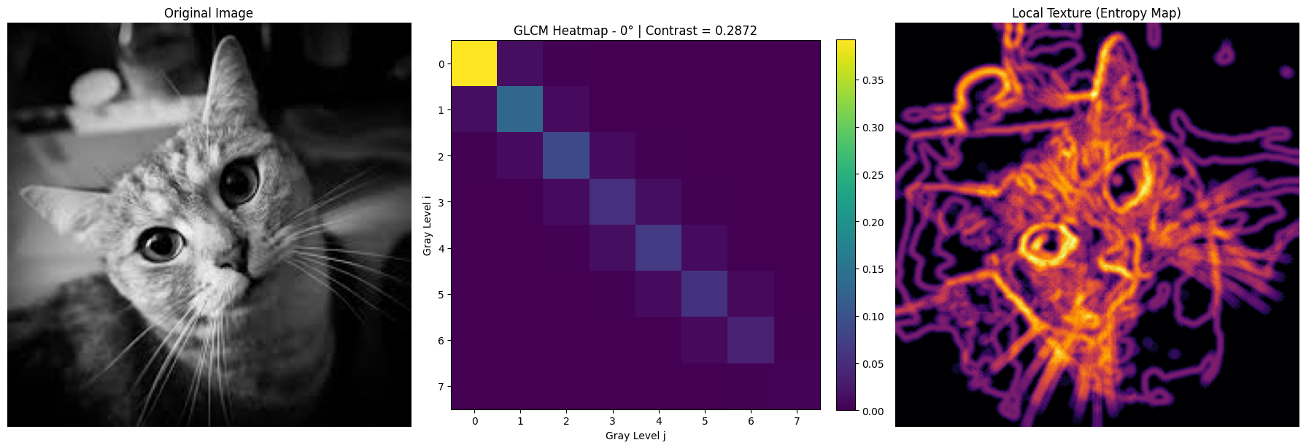
Example

Slide 26
Advantages of GLCM
Captures texture, not just intensity
  Considers pairs of pixels → encodes spatial structure, helpful for distinguishing textures with similar histograms.
Flexible
  You can choose different directions and distances to capture anisotropic textures (e.g., vertical stripes vs horizontal stripes).
Interpretable features
  Features like contrast, energy, and homogeneity have intuitive meanings (rough vs smooth, homogeneous vs heterogeneous).

Slide 27
Limitations of GLCM
Parameter sensitivity
  Results depend on:
    Number of gray levels 𝐿 (quantization),
    Choice of distance 𝑑,
    Choice of directions (0°, 45°, 90°, 135°, etc.).
High dimensionality for many gray levels
  For an 8-bit image with 256 gray levels, GLCM is 256×256 → 65,536 entries per direction and distance → heavy in memory and computation.
Not inherently rotation/scale invariant
  Changing the rotation of the image changes the GLCM unless you average over multiple directions.

Slide 28
Limitations of GLCM
Sensitive to noise and illumination changes
  Small changes in intensities (noise, illumination) can affect co-occurrence counts.
Global unless localized
  A single GLCM for the whole image may miss local variations; often people compute GLCM over moving windows, which increases computation.

Slide 29
Applications of GLCM
Medical Imaging
  Tumor vs normal tissue classification in CT, MRI, ultrasound, histopathology, etc. GLCM features often help characterize tissue heterogeneity.
Remote Sensing and Land Cover Classification
  Distinguish forests, urban areas, water bodies based on texture in satellite images.
Industrial Inspection
  Detect surface defects (scratches, cracks, fabric defects, paper quality, etc.) from textures.
Object Detection & Pattern Recognition
  Use GLCM features as inputs to machine learning models for object detection, texture classification, etc.

Slide 30
Local Binary Pattern (LBP)
CSE523 – Digital Image Processing

Slide 31
Local Binary Pattern (LBP)
LBP:
Examine a pixel relative to its neighborhood:
  Compare neighbor values to center pixel
  Form binary pattern indicating structure
It tells - are neighbors brighter or darker than the center?
This effectively captures: Edges, Corners, Spots, Flat regions, Micro-texture.

Slide 32
Main mechanism of LBP
Consider a grayscale image 𝐼(𝑥,𝑦)
Step 1: Neighborhood (3×3 window)
P₀ | P₁ | P₂
P₇ | P_{c} | P₃
P₆ | P₅ | P₄

Slide 33

Main mechanism of LBP
Step 2: $s\left(pk​−pc\right)$
Step 3: Binary decision
$$s\left(x\right)=\left\{\begin{aligned}0, x<0 \\ &1, x≥0\end{aligned}\right.\text{​}$$
P₀ | P₁ | P₂
P₇ | P_{c} | P₃
P₆ | P₅ | P₄

Slide 34

Main mechanism of LBP
Step 2:$s\left(pk​−pc\right)$
Step 3: Binary decision
$$s\left(x\right)=\left\{\begin{aligned}0, x<0 \\ &1, x≥0\end{aligned}\right.\text{​}$$
P₀ | P₁ | P₂
P₇ | P_{c} | P₃
P₆ | P₅ | P₄

Slide 35

Main mechanism of LBP
Step 4: 2^{k} matrix
Step 5: LBP encoding
$$LBP(pc​)=\sum_{k=0}^{k=7}{s\left(pkc​−pc\right)⋅2k }$$
2⁰ | 2¹ | 2²
2⁷ | P_{c} | 2³
2⁶ | 2⁵ | 2⁴
1 | 2 | 4
128 | Pc | 8
64 | 32 | 16

Slide 36
Example
Consider a grayscale image 𝐼(𝑥,𝑦)
Step 1: Neighborhood (3×3 window)
P_{c}
3 | 7 | 2
8 | 4 | 1
2 | 3 | 5

Slide 37


Example
Step 2: $s\left(pk​−pc\right)$
P_{k}
3 | 7 | 2
8 | 4 | 1
2 | 3 | 5
0
 | P_{c}
P_{c}
Binary Matrix

Slide 38
Example
Step 2: $s\left(pk​−pc\right)$
P_{k}
3 | 7 | 2
8 | 4 | 1
2 | 3 | 5
0 | 1
 | P_{c}
P_{c}
Binary Matrix

Slide 39
Example
Step 2: $s\left(pk​−pc\right)$
P_{k}
3 | 7 | 2
8 | 4 | 1
2 | 3 | 5
0 | 1 | 0
 | P_{c}
P_{c}
Binary Matrix

Slide 40
Example
Step 2: $s\left(pk​−pc\right)$
3 | 7 | 2
8 | 4 | 1
2 | 3 | 5
0 | 1 | 0
 | P_{c} | 0
P_{c}
P_{k}
Binary Matrix

Slide 41
Example
Step 2: $s\left(pk​−pc\right)$
3 | 7 | 2
8 | 4 | 1
2 | 3 | 5
0 | 1 | 0
 | P_{c} | 0
 |  | 1
P_{c}
P_{k}
Binary Matrix

Slide 42
Example
Step 2: $s\left(pk​−pc\right)$
3 | 7 | 2
8 | 4 | 1
2 | 3 | 5
0 | 1 | 0
 | P_{c} | 0
 | 0 | 1
P_{c}
Binary Matrix
P_{k}

Slide 43
Example
Step 2: $s\left(pk​−pc\right)$
3 | 7 | 2
8 | 4 | 1
2 | 3 | 5
0 | 1 | 0
 | P_{c} | 0
0 | 0 | 1
P_{c}
Binary Matrix
P_{k}

Slide 44
Example
Step 2: $s\left(pk​−pc\right)$
P_{c}
P_{k}
3 | 7 | 2
8 | 4 | 1
2 | 3 | 5
0 | 1 | 0
1 | P_{c} | 0
0 | 0 | 1
Binary Matrix

Slide 45
Example
Step 2: $s\left(pk​−pc\right)$
3 | 7 | 2
8 | 4 | 1
2 | 3 | 5
0 | 1 | 0
1 | P_{c} | 0
0 | 0 | 1
Binary Matrix

Slide 46
Example
Step 3: LBP encoding
0 | 1 | 0
1 | P_{c} | 0
0 | 0 | 1
1 | 2 | 4
128 | Pc | 8
64 | 32 | 16
0 | 2 | 0
128 | P_{c} | 0
0 | 0 | 16
Binary Matrix
2^{k} matrix
LBP

Slide 47

Example
$$\sum_{i=0}^{n}{2+128+16=146}$$
Step 3: LBP encoding
0 | 1 | 0
1 | P_{c} | 0
0 | 0 | 1
1 | 2 | 4
128 | Pc | 8
64 | 32 | 16
0 | 2 | 0
128 | P_{c} | 0
0 | 0 | 16
Binary Matrix
2^{k} matrix
LBP

Slide 48
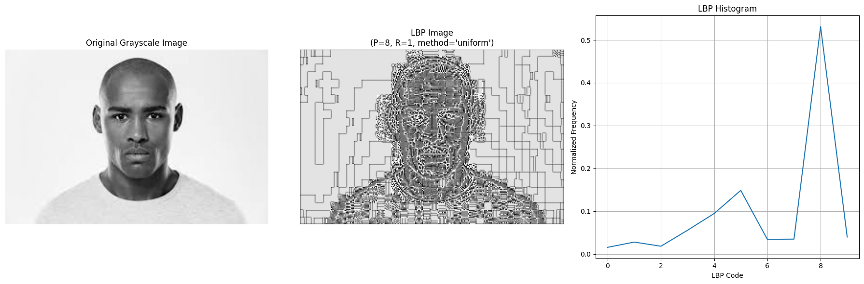
Example

Slide 49
Local Feature → Global Representation
After computing LBP for every pixel, we obtain a texture map.
We extract a histogram of LBP values
Histogram becomes the final feature vector used for:
Classification
Segmentation
Recognition
Anomaly detection

Slide 50
Advantages of LBP
Very fast and simple to compute.
Works well even when lighting changes (brightness/contrast changes).
Captures local texture patterns like edges, corners, and spots.
Produces features that are easy to use in machine learning.
Low memory usage → suitable for real-time systems

Slide 51
Limitations of LBP
Sensitive to noise, especially in flat or low-contrast areas.
Only captures local information → misses global or large-scale patterns.
Standard LBP is not rotation-invariant unless improved versions are used.
Binary thresholding (≥ or <) may lose fine intensity differences.
Histogram features can become large if many neighborhoods are used

Slide 52
Applications of LBP
Face recognition (LBPH algorithm).
Medical image analysis — detecting tumors or abnormal tissue textures.
Industrial inspection — detecting cracks, scratches, or surface defects.
Surveillance — human and object detection.
Remote sensing — land-use and vegetation texture classification.
Document analysis — paper texture and print quality recognition.
Agricultural imaging — plant disease texture detection

Slide 53
Comparison
LBP vs GLCM Features
Feature Type | LBP | GLCM
Complexity | Low | Medium
Uses Local Info? | ✔ | ✔
Histogram size | Small-medium | Depends on L, D, angles
Dataset size required | Small | Small
Explainability | High | Medium

Slide 54

Thanks!

